Slide 1



Leveraging Kaggle Dataset: Exploring Cardiovascular Patient Data with Power BI
PRESENTED BY ASHIAT ADEOGUN

Slide 2
agenda
Objectives Identify, Evaluate, and Examine(IEE)
Introduction​ Cardiovascular Patient
Methodology Power BI
Proposed Solutions Result of the Analysis
​Conclusions Summary​
11/27/2023
Ashiat Adeogun
Cardiovascular Patient Analysis

Slide 3

Objectives
Identify
Identify key risk factors (age, gender, smoking-status) for stroke, hypertension, and heart disease in the dataset to inform prevention strategies.
Evaluate
Determine the frequency of stroke, hypertension, and heart disease and understand how they affect various demographic groups within the dataset.
Examine
Examine combinations of heart disease, hypertension, and stroke to uncover patient co-occurrence patterns within the dataset.
Cardiovascular Patient Analysis

Slide 4
WhO is cardiovascular patient
A "cardiovascular patient" is a broad term that refers to an individual who has a medical condition or health issue related to the cardiovascular system, which includes heart and blood vessels. Cardiovascular patients may have various heart and vascular problems, and they often require medical care and attention to manage their condition.
11/27/2023
Ashiat Adeogun

Slide 5
About the ANALYZED DATASET
The dataset consists of the following variables:
Gender
Age
Hypertension
Heart_disease
Stroke
Ever_married
Work_type
Residence_type
Avg_glucose_level
Body mass index(BMI)
Smoking_status
Patient id
The dataset consists of the following variables:
Patient id
Gender
Age
Hypertension
Heart_disease
Stroke
Ever_married
Work_type
Residence_type
Avg_glucose_level
Body mass index(BMI)
Smoking_status
11/27/2023
Ashiat Adeogun
Cardiovascular Patient Analysis

Slide 6
WHAT IS POWER BI?
Power BI is a business analytics service by Microsoft. It aims to provide interactive visualizations and business intelligence capabilities with an interface simple enough for end users to create their own reports and dashboards.
Microsoft Power BI is a business intelligence platform that provides nontechnical business users with tools for aggregating, analyzing, visualizing and sharing data.
It allows users to connect to various data sources, transform data, and create interactive visuals and reports to help organizations make data-driven decisions.
11/27/2023
Ashiat Adeogun
Cardiovascular Patient Analysis

Slide 7
COMPONENTS OF POWER BI
Power BI consists of 9 components
Power Query: is a data mashup and transformation tool.
Power Pivot: is for data model and analysis.
Power View: is a data visualization tool
Power Map: offers a 3D geospatial data visualization tool
Power Q&A: serves as a natural language question and answering engine
Power BI Desktop: is a robust development tool for Power BI
Power BI Mobile Apps: support in Android, Apple, and Windows Phones.
Power BI Service: allows sharing and hosting of Power BI data analysis as a cloud service
11/27/2023
Ashiat Adeogun
Cardiovascular Patient Analysis

Slide 8
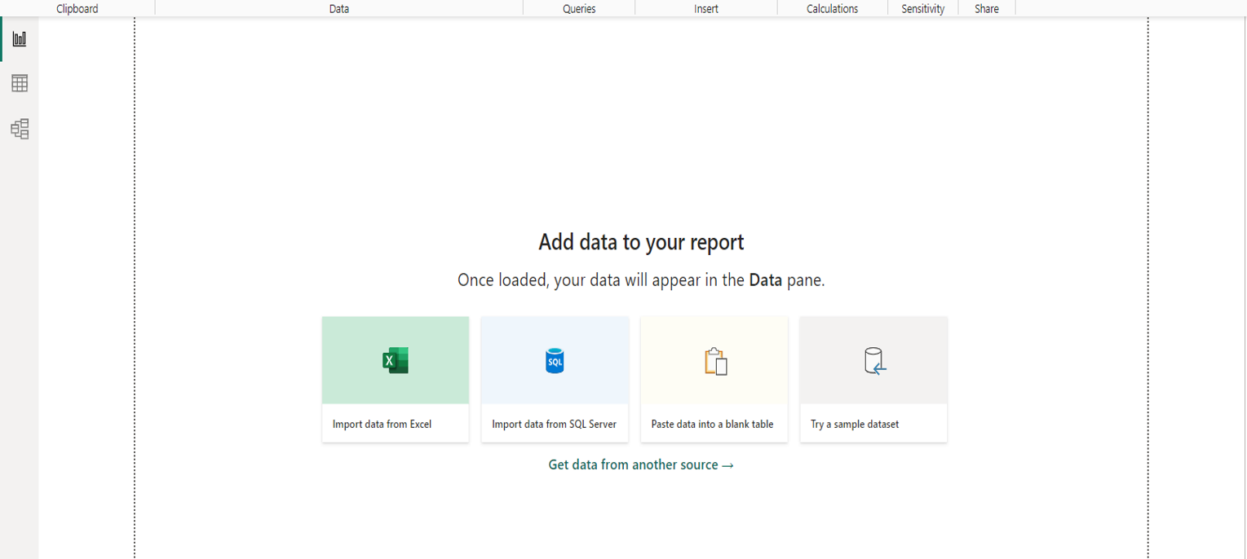
There are three views in Power BI Desktop
Report: In this view, you create reports and visuals, where most of your creation time is spent.
Data: It is a workspace or view that allows you to interact with the data within your dataset. You can use it to explore, transform, and prepare the data for creating reports and visualizations.
Model: In this view, you see and manage the relationships among tables in your data model.
11/27/2023 Ashiat Adeogun Cardiovascular Patient Analysis

Slide 9
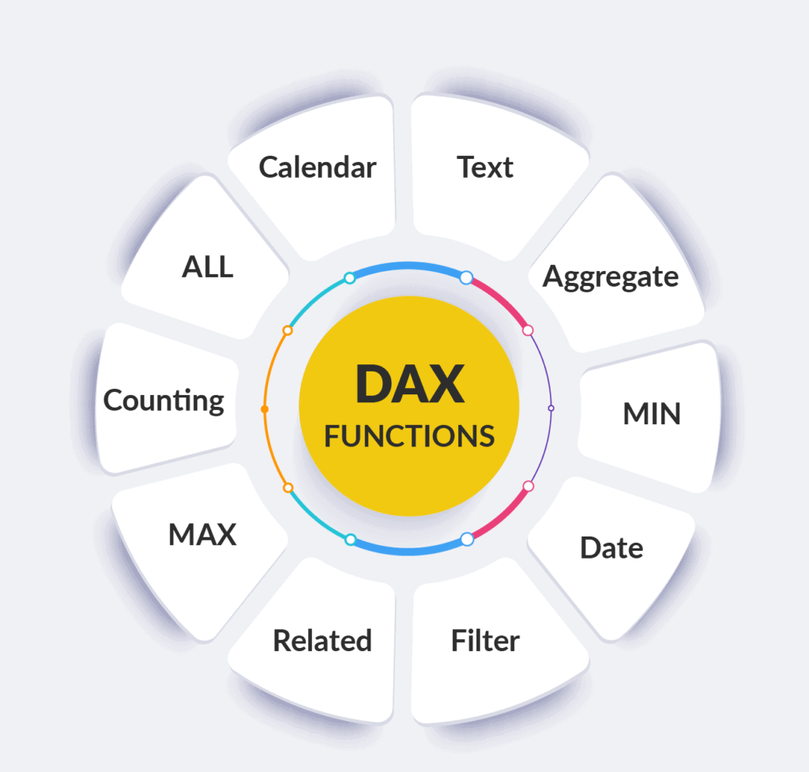
What is data analysis expressions(dax)
It serves as a formula language and query language utilized in Power BI. It encompasses a collection of functions, operators, and constants incorporated into formulas or expressions to calculate and yield one or more values. This language empowers users to extract new insights from their existing data within Power BI models.
Example:
Heart_Disease Patients =
SUMX(
FILTER(
'healthcare-dataset-stroke-data',
'healthcare-dataset-stroke-data'[heart_disease] = 1
),
1
)
11/27/2023 Ashiat Adeogun Cardiovascular Patient Analysis

Slide 10
CALCULATED COLUMN AND MEASURE IN DAX
Calculated column
In Power BI, a calculated column is a column you add to an existing table in the data model. It is calculated during the data loading process, and the results are saved in the Power BI model. A computed column's formula is calculated for each row in a table.
Measure
A measure is a calculation executed on the fly while interacting with your Power BI reports using DAX (Data Analysis Expressions). Measures are used in visuals, pivot tables, and pivot charts.
11/27/2023 Ashiat Adeogun Cardiovascular Patient Analysis

Slide 11
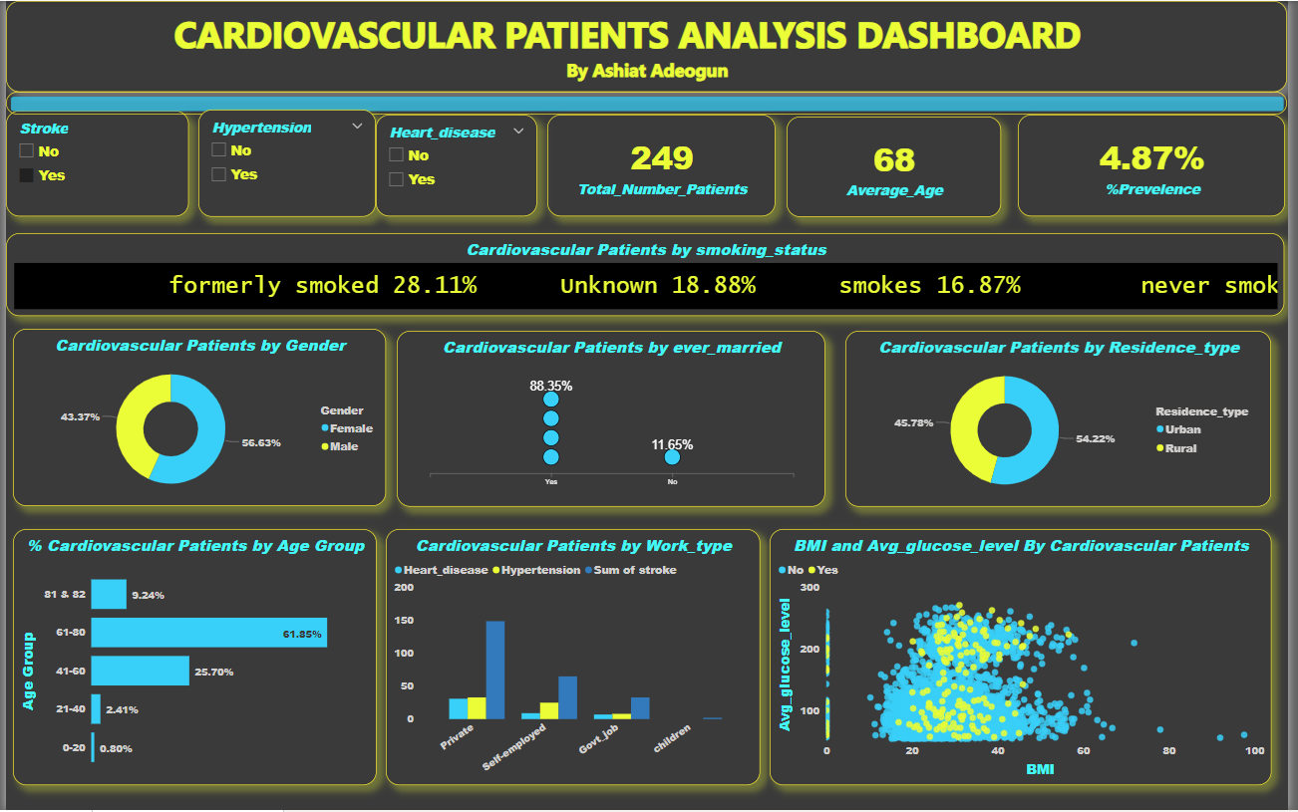
Stroke patients
Key findings are:
The average age of stroke patients is 68, with a 4.87% prevalence and a slight female predominance.
Most (88.35%) are married, and 61.85% are aged 61–80. Smoking habits include 28.11% of former smokers and 16.87% of current smokers.
There are significant difference exists between urban (54.22%) and rural (45.78%) distributions, with private sector dominance in work types evident among stroke patients.
Recommendations:
Tailor stroke prevention for ages 61–80, emphasizing smoking cessation and lifestyle changes.
Provide marital and occupational support, implement comprehensive strategies in both urban and rural areas, and foster an integrated healthcare approach for effective stroke reduction.
11/27/2023 Ashiat Adeogun Cardiovascular Patient Analysis

Slide 12
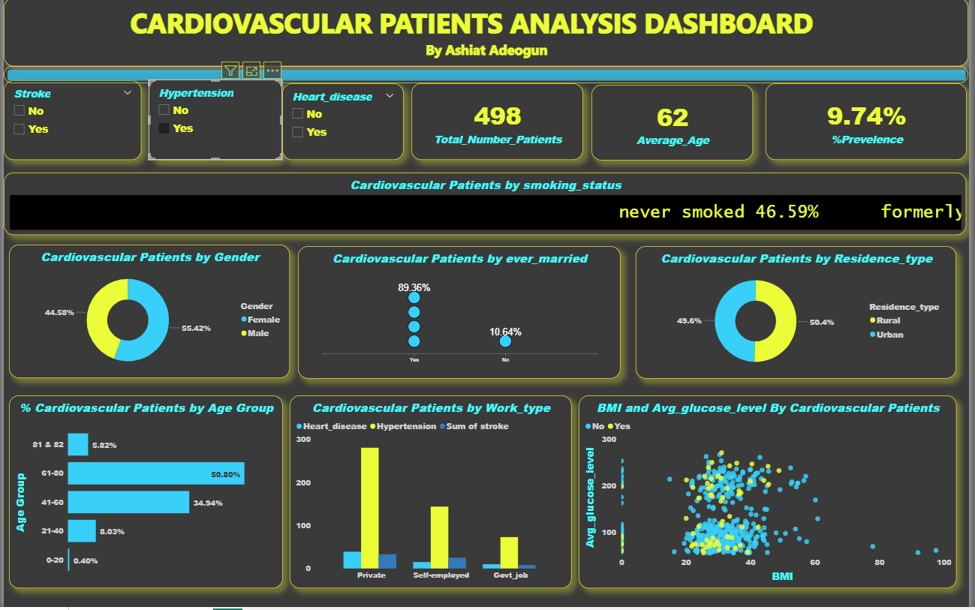
Hypertensive patients
Key findings are:
Hypertensive patients, with an average age of 62years, are slightly younger, comprising of 9.74% cases.
Females account for 55.42%, and 50.80% fall within the 61-80 age group.
Most are married, residing evenly in urban and rural areas, with a significant prevalence of private sector occupations.
Recommendations:
Tailor hypertension interventions for ages 61-80, focusing on females, offering regular screenings and community workshops.
Enhance accessibility through telehealth, cultural sensitivity, and family-based initiatives.
Advocate for policies supporting healthier lifestyles and foster collaborative research for continuous improvement.
11/27/2023 Ashiat Adeogun Cardiovascular Patient Analysis

Slide 13
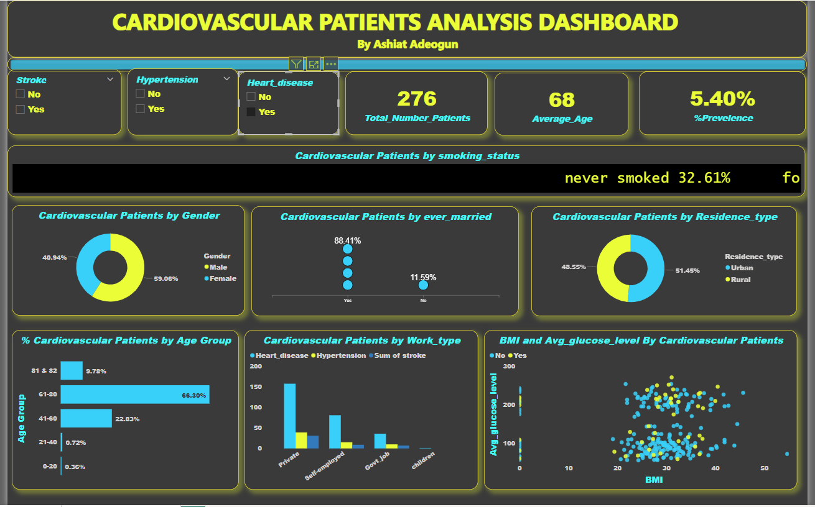
Heart_disease patients
Key findings are:
Patients with heart disease average 68 years, comprising 5.40% of cases, with a higher male proportion of 59%. Like hypertensive patients,
Most are married, and 66.30% fall within the 61-80 age group. Slightly more reside in urban areas, constituting 51.45%, with private sector dominance in work types evident among the patients.
Recommendations:
Tailor cardiac care for ages 61-80, emphasizing male-specific initiatives.
Implement family support programs, conduct urban health campaigns, and collaborate with the private sector.
Integrate mental health support, encourage regular physical activity, and use technology for monitoring.
11/27/2023 Ashiat Adeogun Cardiovascular Patient Analysis

Slide 14
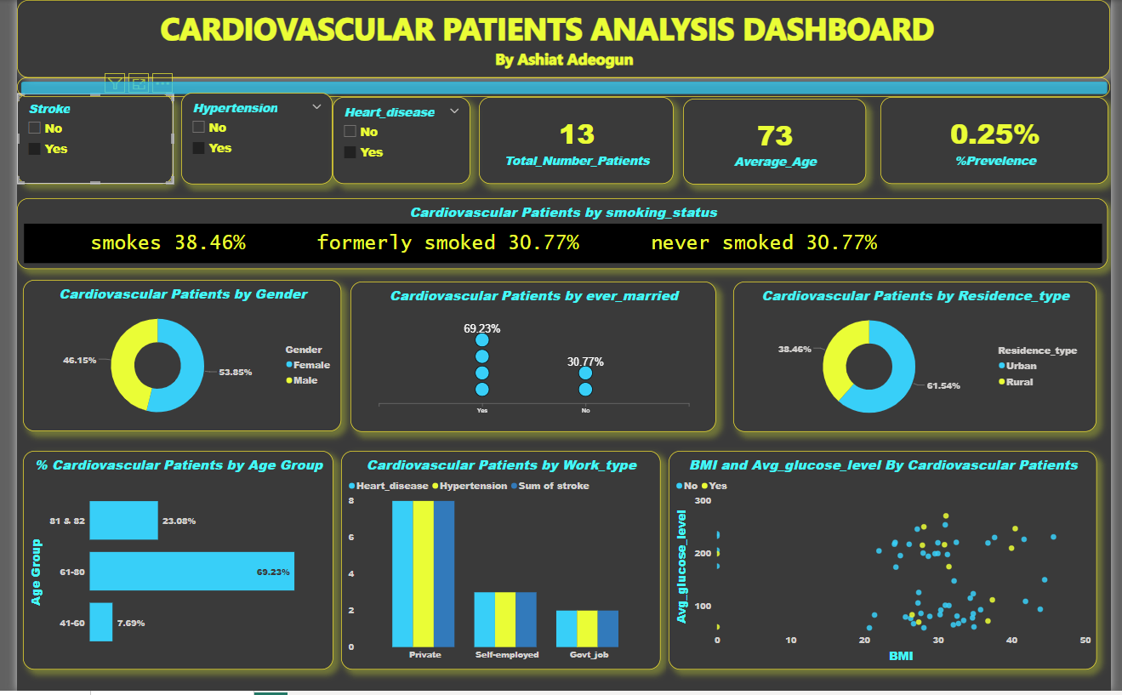
patients with multiple conditions
Key findings are:
Individuals managing multiple conditions, averaging 73 years, comprise 0.25% of cases, with 38.46% smokers and 30.77% former smokers.
Approximately 61.54% reside in urban areas, and 69.23% are aged 61-80.
Those with heart disease and hypertension, hypertension and stroke, or heart disease and stroke tend to be older.
While heart disease and hypertension cases show an even urban-rural distribution, hypertension, and stroke cases have a higher percentage of females.
Those simultaneously managing heart disease, hypertension, and stroke are older and predominantly urban residents.
Recommendations:
Tailor integrated care for individuals managing multiple conditions, focusing on smokers aged 61-80 in urban areas.
Implement age-specific interventions for various conditions, address varied demographics, and promote comprehensive healthcare.
11/27/2023 Ashiat Adeogun Cardiovascular Patient Analysis

Slide 15
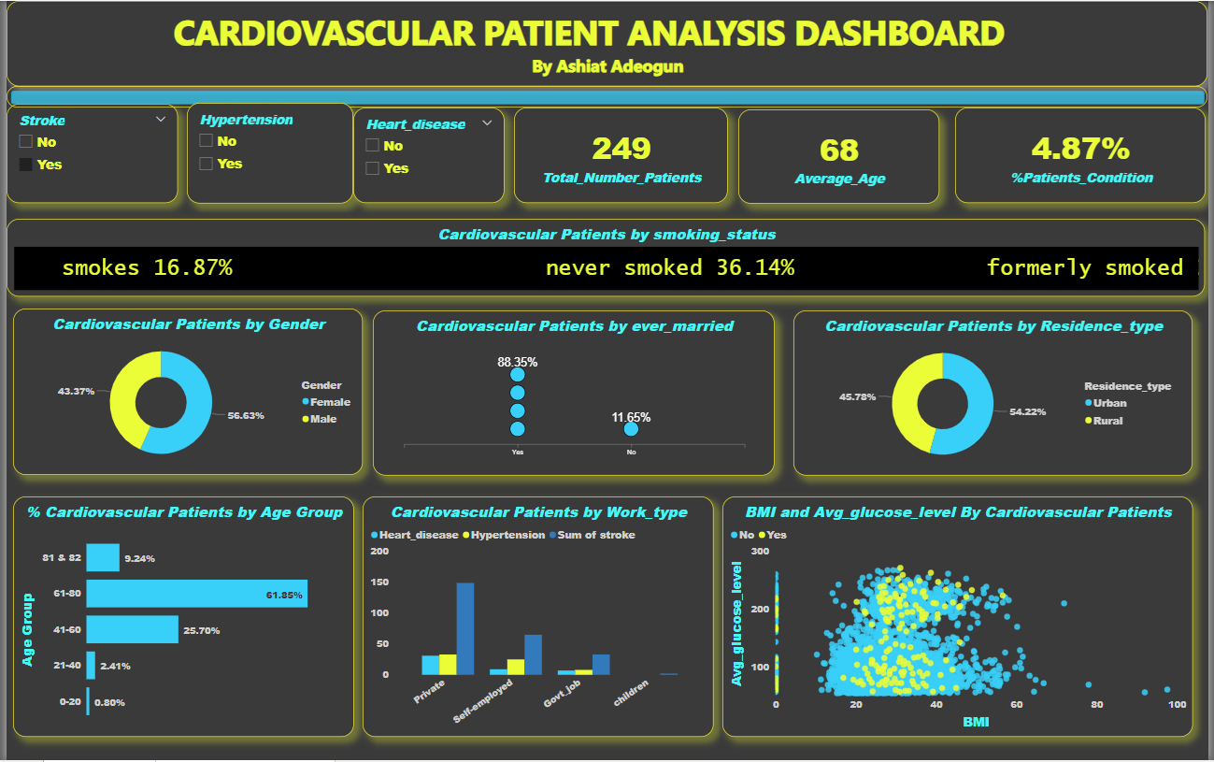
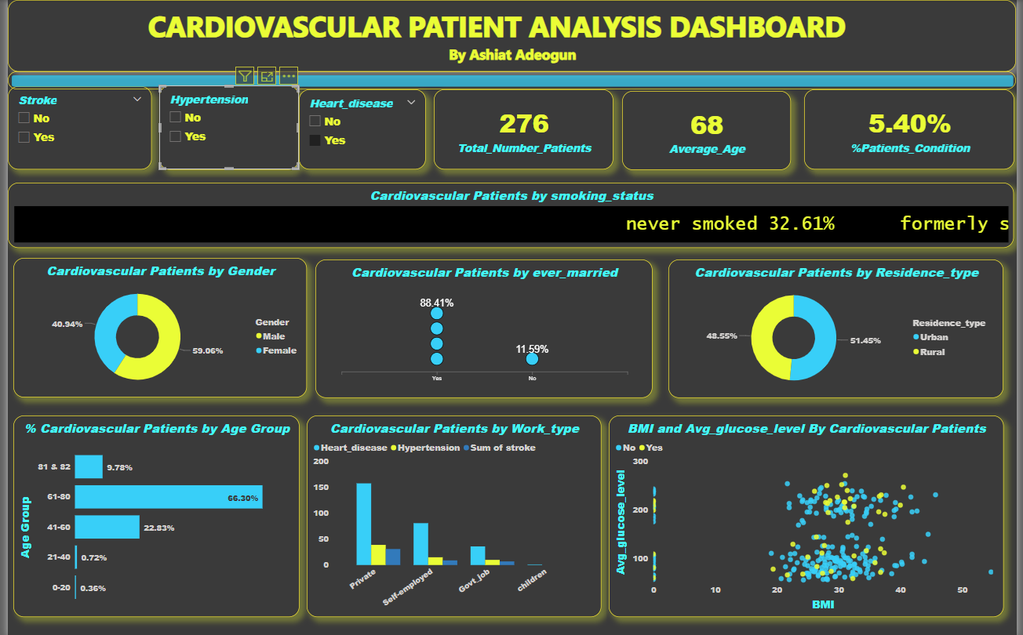
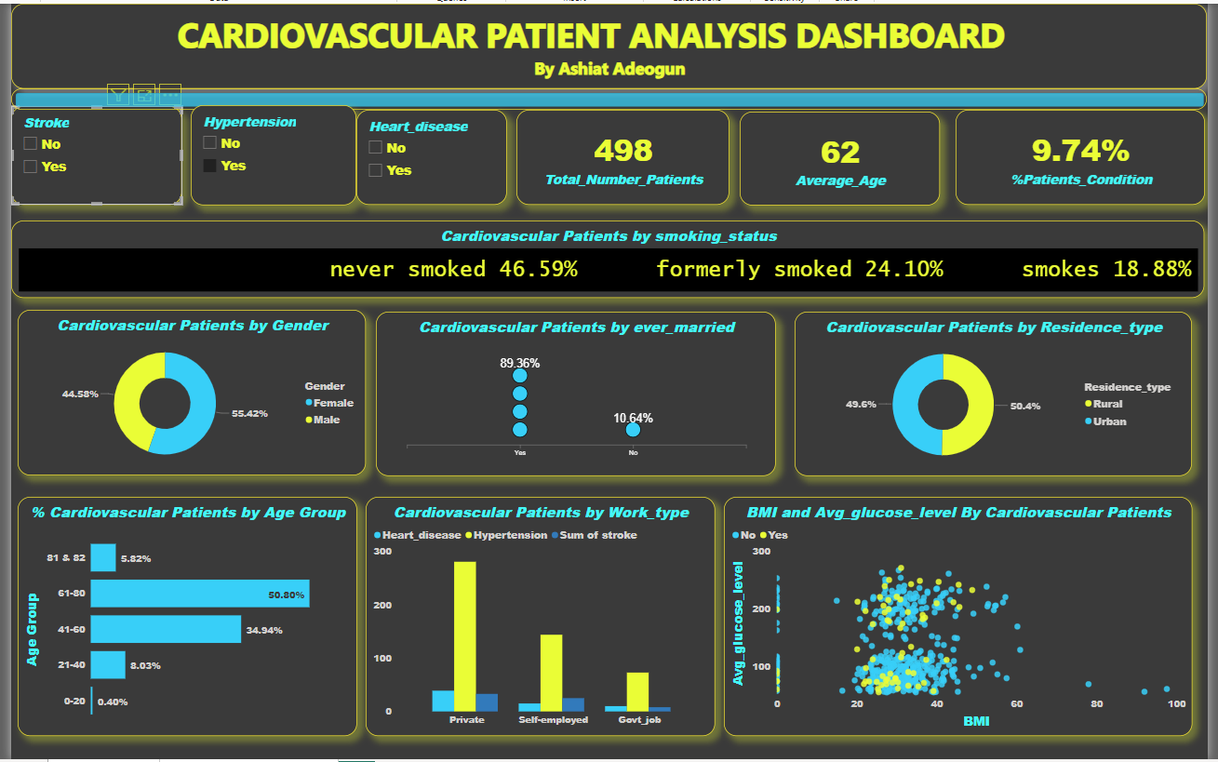
THe comparison between three categories
STROKE PATIENTS
HEART DISEASE PATIENTS
HYPERTESIVE PATIENTS
11/27/2023 Ashiat Adeogun Cardiovascular Patient Analysis

Slide 16

CONCLUSIONS
Demographic patterns in stroke, hypertension, and heart disease patients reveal age, gender, and urban-rural variations.
Power BI enhances data accessibility and visualization for informed healthcare interventions and decision-making.
11/27/2023
Ashiat Adeogun
Cardiovascular Patient Analysis

Slide 17
Thank you. Any questions!
aaa2ev@mtmail.mtsu.edu
https://www.linkedin.com/in/asiat2/
https://github.com/asiat2/Cardiovascular-Healthcare-Analysi
11/27/2023 Ashiat Adeogun Cardiovascular Patient Analysis

